Slide 1
Computer System Architecture
Fifth week’s Report
名前：劉立坤
学籍番号：2IE19337P

Slide 2
Laptop Lenovo P52
Processor
Intel® Core™ i7-8850H @ 2.60GHz
Power Saving Functions
C-States power saving modes
P-States power saving modes (Speed Step)
Intel Turbo Boost

Slide 3
Smart phone iPhone SE
Processor
Apple A9
Power saving functions
Run/Standby/Shutdown/Dormant modes
Processor speed reduction

Slide 4
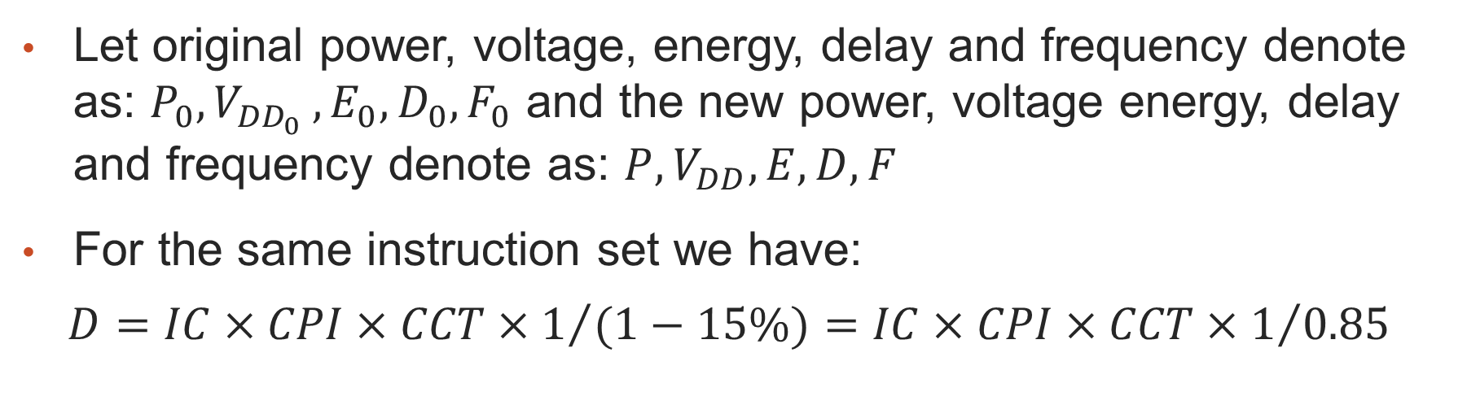
Impact on power and energy consumption by reducing clock speed
Let original power, voltage, energy, delay and frequency denote as: $P_{0},V_{{DD}_{0} },E_{0},D_{0},F_{0}$ and the new power, voltage energy, delay and frequency denote as: $P,V_{DD},E,D,F$
For the same instruction set we have:
$$D=IC×CPI×CCT×1/{(1−15\%)}=IC×CPI×CCT×1/{0.85}$$

Slide 5
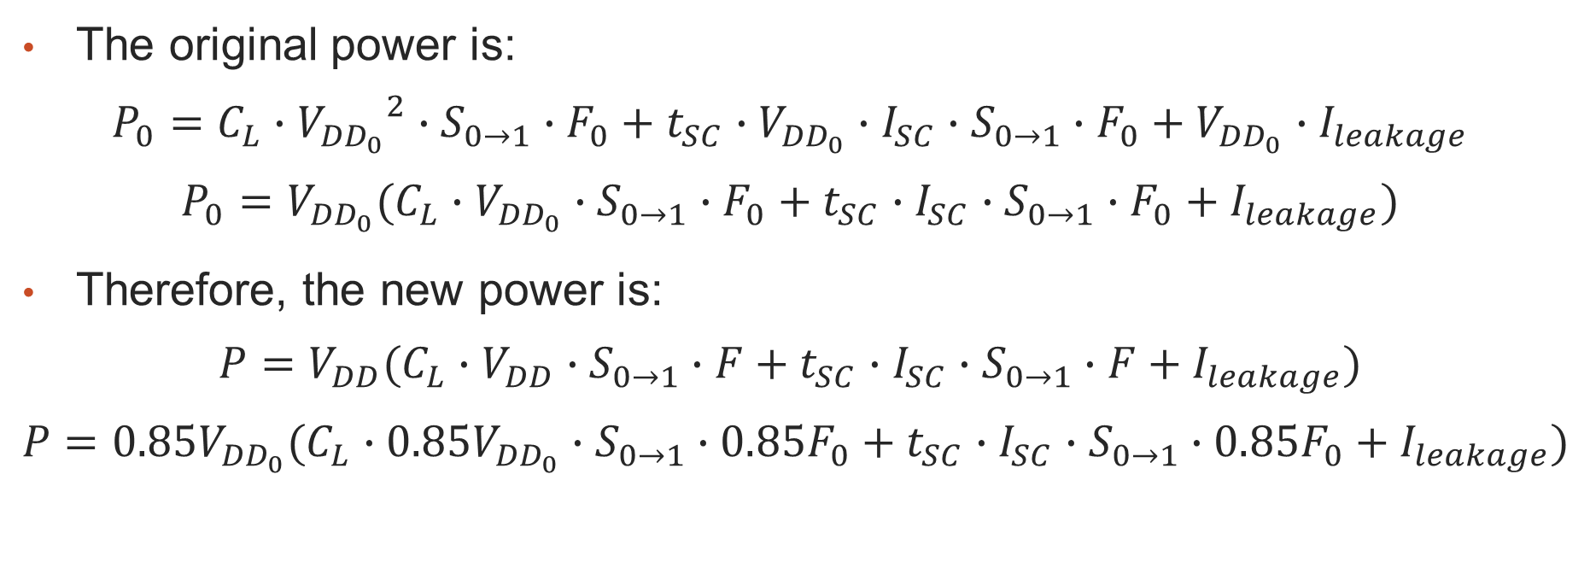
Impact on power and energy consumption by reducing clock speed
The original power is:
$$P_{0}=C_{L}∙{V_{{DD}_{0}}}^{2}∙S_{0→1}∙F_{0}+t_{SC}∙V_{{DD}_{0}}∙I_{SC}∙S_{0→1}∙F_{0}+V_{{DD}_{0}}∙I_{leakage}$$
$$P_{0}=V_{{DD}_{0}}(C_{L}∙V_{{DD}_{0}}∙S_{0→1}∙F_{0}+t_{SC}∙I_{SC}∙S_{0→1}∙F_{0}+I_{leakage})$$
Therefore, the new power is:
$$P=V_{DD}(C_{L}∙V_{DD}∙S_{0→1}∙F+t_{SC}∙I_{SC}∙S_{0→1}∙F+I_{leakage})$$
$$P=0.85V_{{DD}_{0}}(C_{L}∙0.85V_{{DD}_{0}}∙S_{0→1}∙0.85F_{0}+t_{SC}∙I_{SC}∙S_{0→1}∙0.85F_{0}+I_{leakage})$$

Slide 6
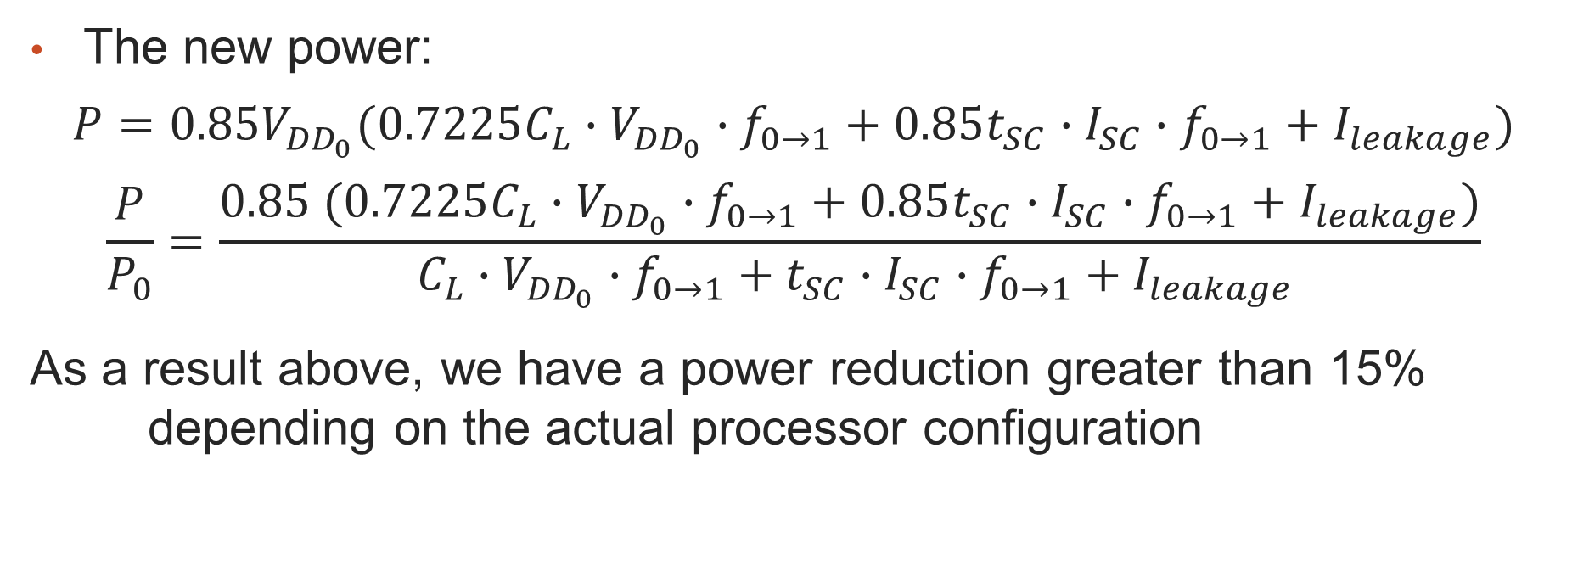
Impact on power and energy consumption by reducing clock speed
The new power:
$$P=0.85V_{{DD}_{0}}(0.7225C_{L}∙V_{{DD}_{0}}∙f_{0→1}+0.85t_{SC}∙I_{SC}∙f_{0→1}+I_{leakage})$$
$$\frac{P}{P_{0}}=\frac{0.85 (0.7225C_{L}∙V_{{DD}_{0}}∙f_{0→1}+0.85t_{SC}∙I_{SC}∙f_{0→1}+I_{leakage})}{ C_{L}∙V_{{DD}_{0}}∙f_{0→1}+t_{SC}∙I_{SC}∙f_{0→1}+I_{leakage}}$$
As a result above, we have a power reduction greater than 15% depending on the actual processor configuration

Slide 7
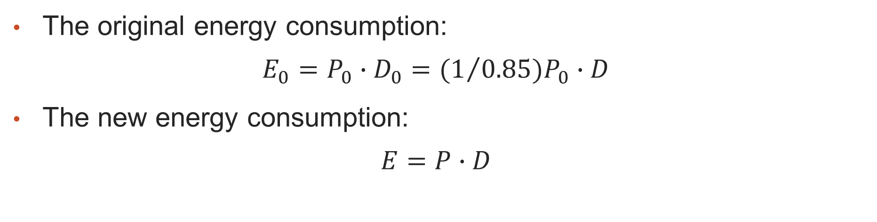
Impact on power and energy consumption by reducing clock speed
The original energy consumption:
$$E_{0}=P_{0}∙D_{0}={{(1}/{0.85})P}_{0}∙D$$
The new energy consumption:
$$E=P∙D$$

Slide 8
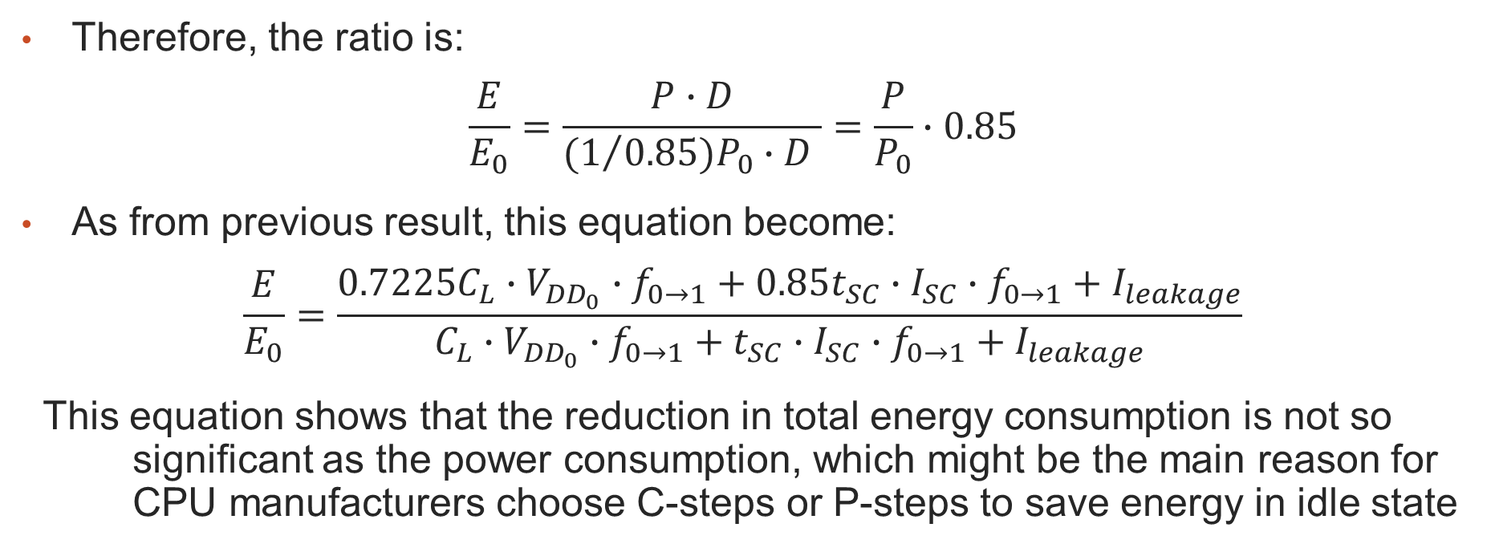
Impact on power and energy consumption by reducing clock speed
Therefore, the ratio is:
$$\frac{E}{E_{0}}=\frac{P∙D}{{{(1}/{0.85})P}_{0}∙D }=\frac{P}{P_{0}}∙0.85$$
As from previous result, this equation become:
$$\frac{E}{E_{0}}=\frac{0.7225C_{L}∙V_{{DD}_{0}}∙f_{0→1}+0.85t_{SC}∙I_{SC}∙f_{0→1}+I_{leakage}}{C_{L}∙V_{{DD}_{0}}∙f_{0→1}+t_{SC}∙I_{SC}∙f_{0→1}+I_{leakage}}$$
This equation shows that the reduction in total energy consumption is not so significant as the power consumption, which might be the main reason for CPU manufacturers choose C-steps or P-steps to save energy in idle state

